Slide 1
Bacillus Anthracis: String of Pearls Reaction
Author: Neal Chamberlain
Citation: Neal Chamberlain. 2015. Bacillus anthracis: string of pearls reaction.
Publication Date: August 2015

Slide 2
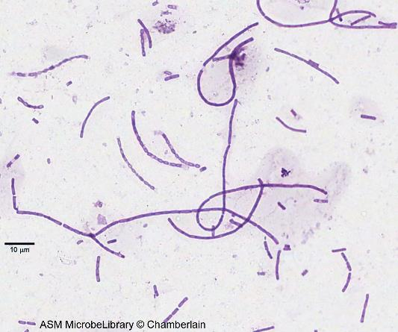
Bacillus anthracis: String of Pearls Reaction
Bacillus anthracis is an aerobic gram-positive endospore-forming rod-shaped bacterium that causes anthrax. The CDC has classified it as a category A bioterrorism agent. Three forms of anthrax affect humans; cutaneous, gastrointestinal, and pulmonary. There are almost 200 Bacillus species that have been characterized. B. anthracis is susceptible to penicillin and incubation on medium containing low levels of penicillin causes the bacterium to swell and form a chain of cells that resemble a string of pearls. Other Bacillus species are resistant to penicillin and do not exhibit this "String of Pearls" reaction.
American Society For Microbiology ©

Slide 3
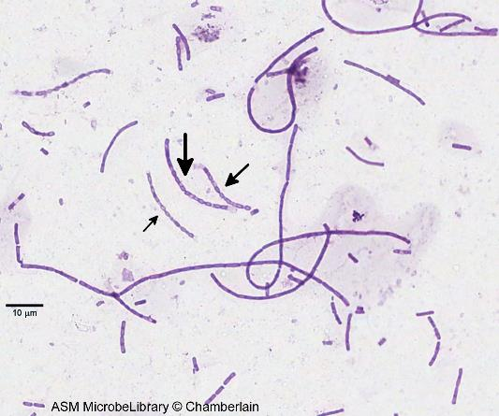
Bacillus anthracis: String of Pearls Reaction (Labeled view)(Labeled view)
American Society For Microbiology ©

